Slide 1
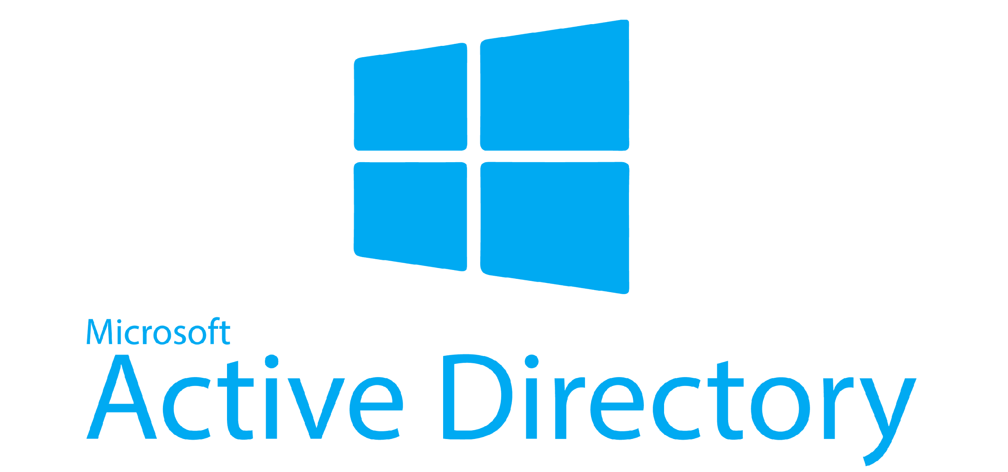

Slide 2
FOREWORD
I will say stuff during this that isn’t on the slides because I either forgot about it while writing the slides or I think it is relevant when I start rambling.

Slide 3
WHAT IS ACTIVE DIRECTORY?
A catchall term most commonly referring to ADDS, Active Directory Domain Services. (originally this was the only thing)
A directory is a hierarchical structure that stores information (think folders)
ADDS allows for this structure to be used to give users access to these structures and provide Identity and Access Management (IAM)
TLDR – AD controls user permissions for accessing stuff

Slide 4
WHY ACTIVE DIRECTORY?
Very few alternatives
Been around forever (1999)
Compatible with pretty much everything (windows, macos, GNU/Linux, BSD etc)
Most organisations primarily run windows (yay for compatibility!)

Slide 5
HOW DOES IT WORK?
In short, very complicated (and DNS).
Could easily do an entire degree in Active Directory
These 2 sessions will attempt to show the basics. If you want to learn more, it is highly recommended as most businesses run AD in some form.

Slide 6
ACTIVE DIRECTORY MAKEUP
Active Directory follows a hierarchical structure
The elements of the structure have fun names to remember because IT engineers hate you
Everything has a name in AD. Somethings have 2 names!
For example: a computer on the domain DMUHACKERS.LOC called COMP1 will have 2 names:
COMP1.DMUHACKERS.LOC – DNS Name
DMUHACKERS\COMP1 – NetBIOS name

Slide 7


WHAT IS THIS?

Slide 8
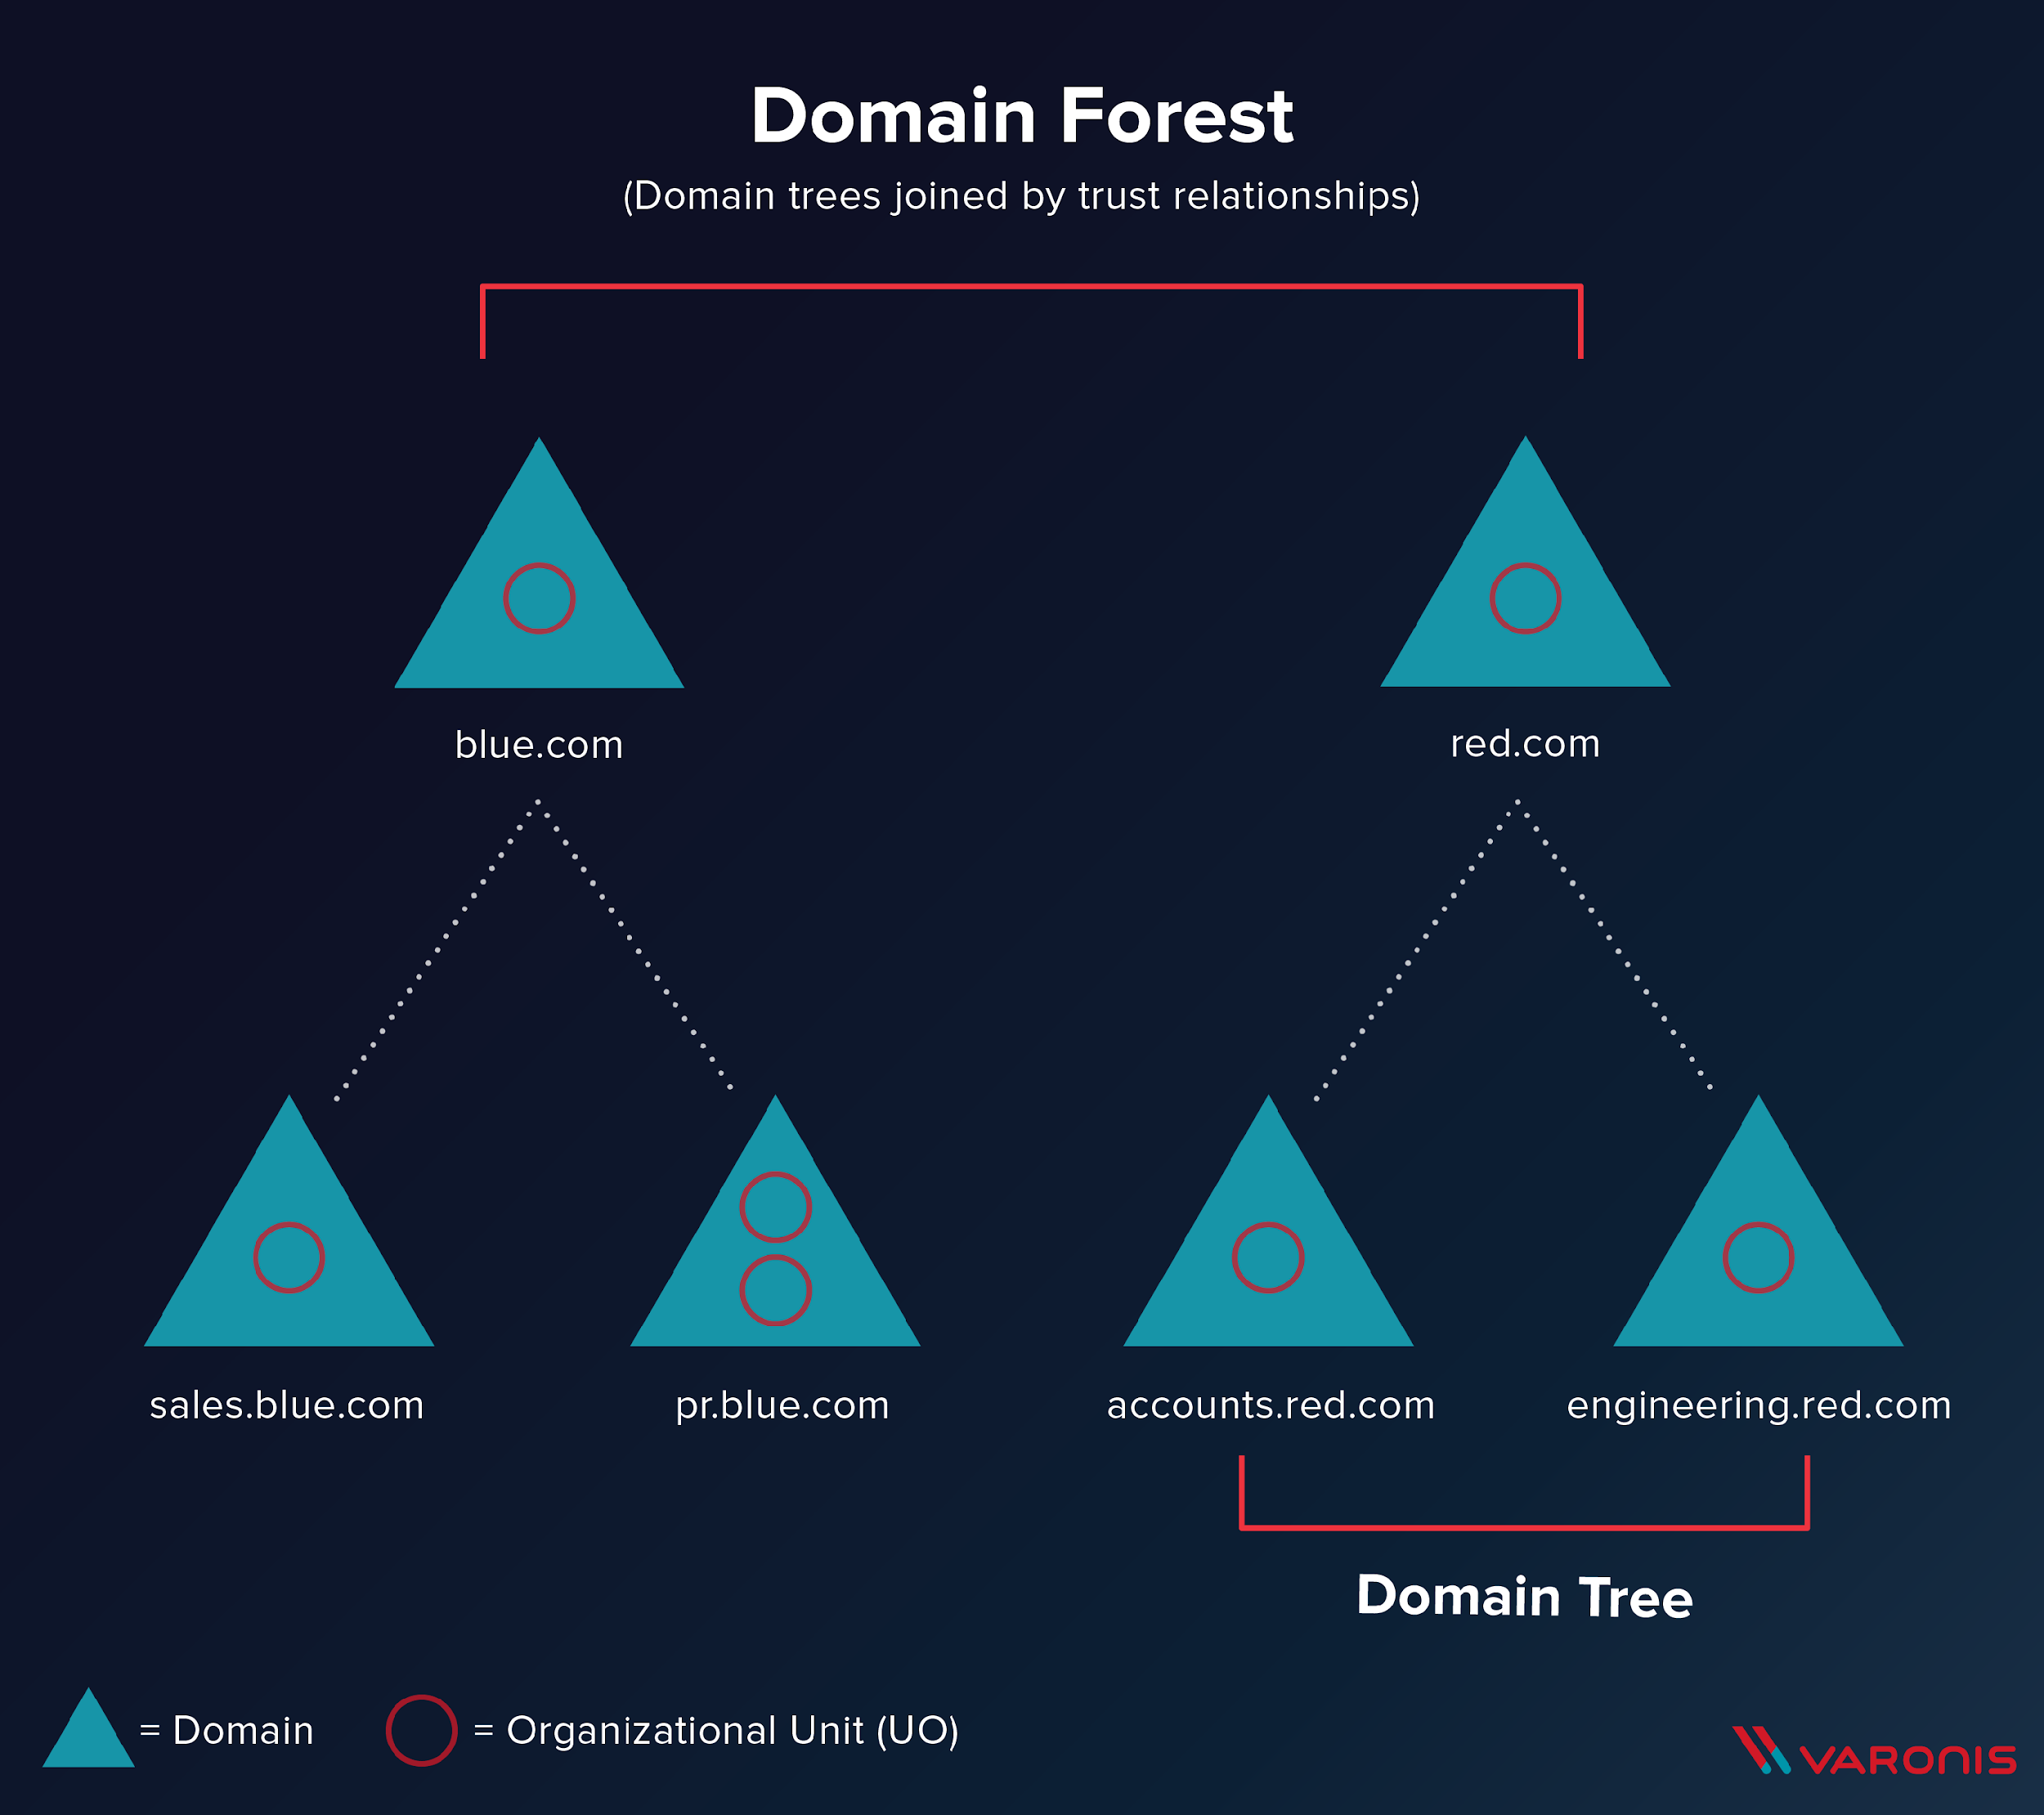
FOREST
“A forest is a collection of one or more Active Directory domains that share a common logical structure, directory schema (class and attribute definitions), directory configuration (site and replication information), and global catalog (forest-wide search capabilities).” – Some Microsoft wizard
TLDR: Collection of domains that share the same structure

Slide 9

WHAT ARE FORESTS MADE OF?

Slide 10
TREES
A domain tree is a “root” domain which has “branching” domains coming off it
For example:
DMUHACKERS.LOC – root domain
Committee.dmuhackers.LOC – branch domain
Members.dmuhackers.LOC – branch domain

Slide 11
WHAT IS A DOMAIN?
“A domain is a partition in an Active Directory forest. Partitioning data enables organizations to replicate data only to where it is needed” – also some Microsoft Wizard
TLDR: separates organisations into smaller bits

Slide 12
HOW ARE DOMAINS MADE UP?
Organizational Units (OUs)
Each domain is made up of OUs. OUs group objects within a domain to organise them and give scope for what objects influence what objects (confused yet?)
OUs are important as it helps provide delegation.
On big domains, it is impossible for 1 person to manage everything. Also, for security reasons you don’t want a load of people to have administrator permissions, hence delegation (we’ll come back to this)

Slide 13
WHAT IS AN OBJECT?
Good question
An object is anything in AD. Could be:
A user
A group of users
Group Policy Object (GPO, we’ll come back to these)
Access Control Lists (ACLs, We’ll come back to these)

Slide 14
GROUP POLICY OBJECTS (GPO)
“Group Policy enables configuration and settings management of user and computer settings on computers running Windows Server and Windows Client operating systems” – The wizard
A GPO is a collection of policies (rules) that the users and computers of a domain MUST conform to. GPOs can be scoped by OU.

Slide 15
EXAMPLES OF THINGS GPOS CAN DO
Set a password policy
Set Remote Access policies
Set user access policies
Etc etc etc

Slide 16
ACCESS CONTROL LISTS (ACL)
Simply put, ACLS control what things people can do and look at. If you’re not on the list, you don’t see it. ACLs are made up of ACEs (Access Control Entity).

Slide 17
DELEGATION
Option 1: The bad way
Give all 4 committee members access to a Domain Administrator (DA) account.
Why is this bad?
Say we have 1 domain, DMUHACKERS.LOC
Say we need all committee members to have the ability to force reset a member's password. How can we do this?
Option 2: The better, but still bad, way
Give all 4 committee members access to their own Domain Administrator (DA) account.
Why is this still bad?

Slide 18
DELEGATION
Option 3: The Best way
Put all 4 committee members into a Group, apply a Group Policy Object to that group allowing them to reset passwords of people in the “members” group.
Why is this the best way?
Say we have 1 domain, DMUHACKERS.LOC
Say we need all committee members to have the ability to force reset a member's password. How can we do this?
Easily scalable
Easy to remove permissions without deleting accounts
Follows Principal of Least Privilege

Slide 19
DEFAULT (IMPORTANT) GROUPS
AD has a boatload of groups by default. You will never need to look at most of them as they are legacy however there are a few important groups
Enterprise Administrators – have control over an entire domain tree/forest (depending on trust setups)
Domain Administrators – Control over the entire domain
Domain Users – default group all users are in
Domain Computers – Default group all computers are in

Slide 20
HOW DO ALL THESE THINGS GET CONTROLLED?
By a Domain Controller! (DC)
A DC is a Windows Server device that has ADDS services installed on it and has been promoted to a domain controller.
The latest version of Windows Server is Windows Server 2025. You won’t find many of these in the wild (YET)

Slide 21
SOME MILD HACKING STUFF QUICKLY
How to identify a Domain Controller? Glad you ask
Domain Controllers need to have certain ports open in order for them to function. For example:
53, 88, 123(UDP), 135, 137/138(UDP)*, 139 (TCP)*, 389, 445, 464, 636, 9389 (brownie points if you can get any of these ports without googling)
Furthermore, quite often DCs will leak their hostnames via SMB. Most orgs call their DCs something useful like DC01.DMUHACKERS.LOC. Not a guaranteed method but still helpful!
Notes:
53 DNS
88 Kerberos
123 W32Time
135 RPC Endpoint Mapper
137/138 NetBios (Not needed since 2012)
139 NetBios (Not needed anymore since 2012)
389 LDAP
445 SMB
464 Kerberos Password Change
636 LDAPs
9399 Active Directory Web Services

Slide 22
WHAT THOSE PORTS WERE
53 DNS
88 Kerberos
123 W32Time
135 RPC Endpoint Mapper
137/138 NetBios (Not needed since 2012)
139 NetBios (Not needed anymore since 2012)
389 LDAP
445 SMB
464 Kerberos Password Change
636 LDAPs
9399 Active Directory Web Services
Notes:
53 DNS
88 Kerberos
123 W32Time
135 RPC Endpoint Mapper
137/138 NetBios (Not needed since 2012)
139 NetBios (Not needed anymore since 2012)
389 LDAP
445 SMB
464 Kerberos Password Change
636 LDAPs
9399 Active Directory Web Services

Slide 23
HOW DOES ONE INTERFACE WITH A DOMAIN CONTROLLER?
LDAP and SMB.
LDAP – Lightweight Directory Access Protocol
SMB – Server Message Block
LDAP is specified in RFC 4510, RFC 4511 (not Microsoft created)
SMB is created by Microsoft

Slide 24
SEMI IMPORTANT SIDE TANGENT
SMB for a period of about 10 years was renamed to CIFS (Common Internet File System).
CIFS was a revamp of SMB1. This is only important as for some reason to this day some parts of AD still refer to it as CIFS not SMB.

Slide 25
AD Computers and where to find them
Computers that are domain joined can be queried by any user*
Can be accomplished using Powershell
Get-ADComputer -Filter * -Property *
This will perform an LDAP query to get all the computers that have been domain joined (if run from a domain joined computer)
Notes:
User must be a domain user and will only get basic data without special permissions

Slide 26
AD Computers and where to find them
AD uses DNS (the DC acts as a DNS server) to allow traffic to go where it needs to go. Every domain joined computer will have an FQDN which is what will be used for requests. DNS magic occurs and boom 2 computers can talk to each other.
Notes:
Example of machine with FQDN - comp1.dmuhackers.loc

Slide 27
HOW TO AUTHENTICATE WITH AD
NTLM Authentication:
The OG way of authentication
Kerberos:
The newer (and much more complicated) way of authentication
How these work will be explained in part 2 as we will look at attacking them!

Slide 28
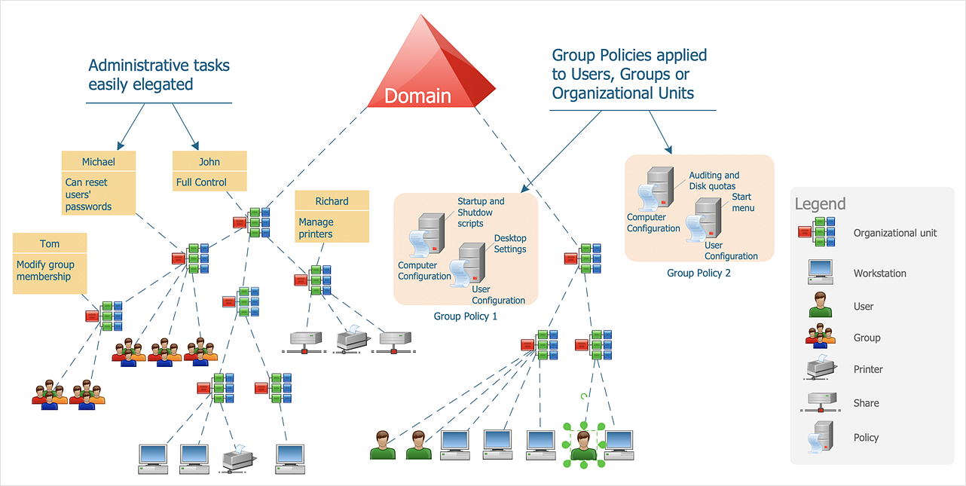

Slide 29
QUICK RECAP/RUNDOWN
A forest contains domain trees
Each Domain Tree contains domains
Each Domain contains at least 1 domain controller
Each Domain contains at least 1 OU
An OU can be used to breakdown a domain into bits and help with delegation
Group Policy Objects are used to control what people can do
Communication within a domain takes place via LDAP and SMB primarily
NetBIOS has been deprecated but because everything is old it still exists
Microsoft suck at security

Slide 30
INTO THE RABBIT HOLE
AD is massive. I’m going to give some examples of attacks in the next few slides as an example of how stupid this bit of kit can be. Some will be explained in greater detail next week with examples of how to perform them.

Slide 31
PASS THE HASH
One of the simplest attacks. A flaw with NTLM authentication (Will explain more next week) allows an attacker to login as a user without their password, only their password hash.
This means an attacker might not ever need to know your password to compromise your account!!!

Slide 32
GPP PASSWORDS
Quite possibly one of the stupidest things Microsoft has done
Every windows computer has an inbuilt Administrator account, it is important that these passwords are unique for every machine and are preferably disabled. However, there was no easy way to do this until Microsoft introduced GPP.
GPP would allow administrators to bulk change passwords by using Group Policy, it would push an XML file to SYSVOL with the relevant changes and the Windows machines would update their policy from that. Cool right? NO!!
GPP (Group Policy Preferences) were files stored on the SYSVOL SMB share on domain controllers. ALL domain users can read this share by design.
For password changes the password would be in the XML file!! Reminder this share is readable by everyone! However, the XML file is encrypted using AES256.
Only one issue, the encryption key is the SAME for EVERY AD instance!! Guess what else, Microsoft published it publicly.

Slide 33
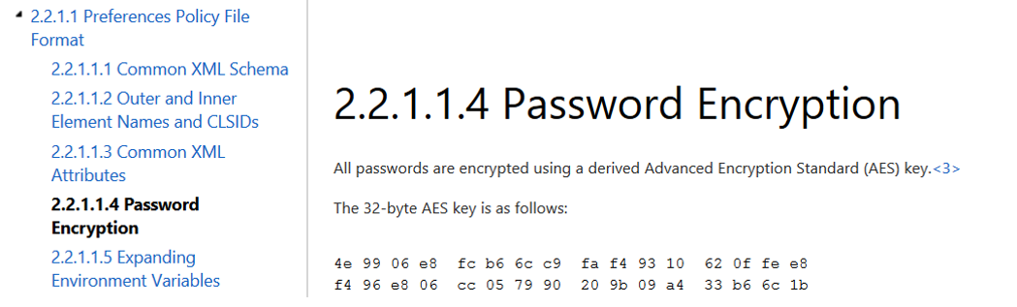

Slide 34
PRE-2000 MACHINE ACCOUNTS
This one is just stupid.
Pre 2000 machine accounts when created had the same password as their machine name. If the machine was called comp1$ the password would be “comp1”

Slide 35
Resources
https://www.thehacker.recipes/
https://book.hacktricks.wiki/en/index.html
https://github.com/infosecn1nja/AD-Attack-Defense

